Slide 1
Quadthagoras!

Slide 2

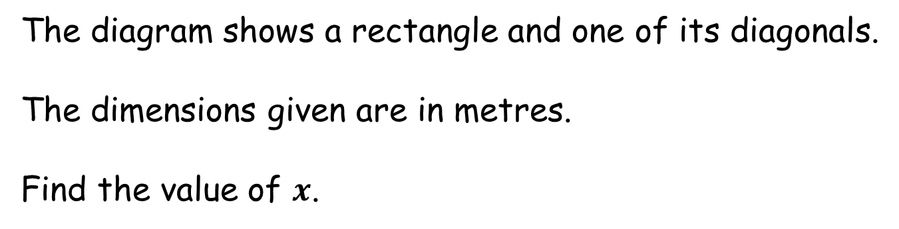


Quadthagoras!
The diagram shows a rectangle and one of its diagonals.
The dimensions given are in metres.
Find the value of $x$.
$$17$$
$$x$$
(not to scale)
$$\frac{1}{2}x+11$$

Slide 3
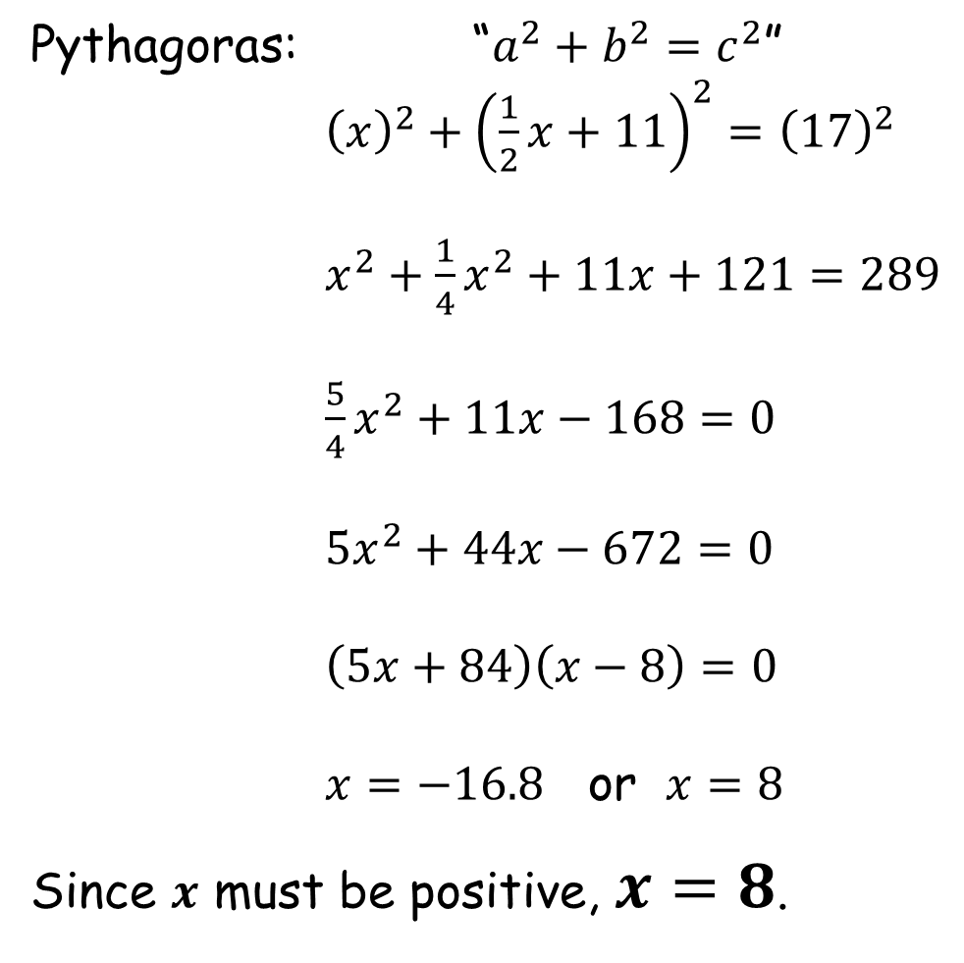
Quadthagoras!
Pythagoras: “$a^{2}+b^{2}=c^{2}$”
${\left(x\right)}^{2}+{\left(\frac{1}{2}x+11\right)}^{2}={\left(17\right)}^{2}$
$x^{2}+\frac{1}{4}x^{2}+11x+121=289$
$\frac{5}{4}x^{2}+11x−168=0$
$5x^{2}+44x−672=0$
$\left(5x+84\right)\left(x−8\right)=0$
$x=−16.8$ or $x=8$
Since $x$ must be positive, $x=8$.

Slide 5
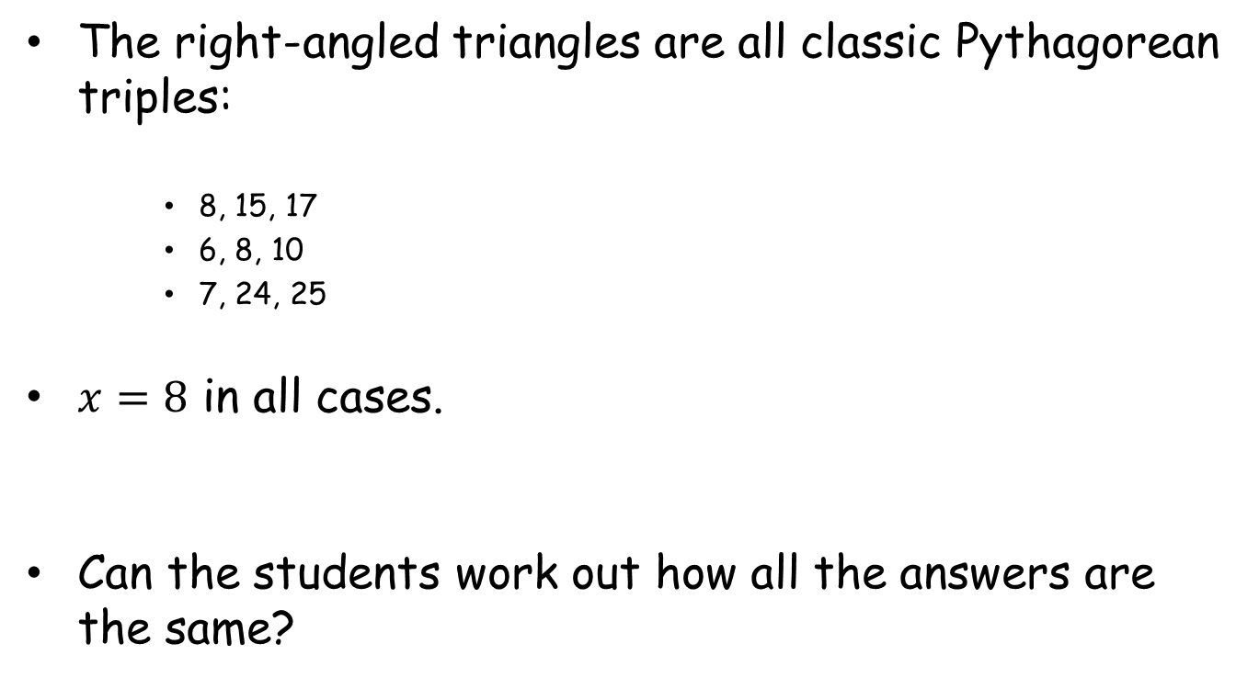
Note to Teacher
The right-angled triangles are all classic Pythagorean triples:
8, 15, 17
6, 8, 10
7, 24, 25
$x=8$ in all cases.
Can the students work out how all the answers are the same?

Slide 6
RESOURCES

Slide 7

SIC_36
Quadthagoras!
The diagram shows a rectangle and one of its diagonals.
The dimensions given are in metres.
Find the value of $x$.
$$17$$
$$x$$
(not to scale)
$$x+7$$

Slide 8

SIC_36
Quadthagoras!
The diagram shows a rectangle and one of its diagonals.
The dimensions given are in metres.
Find the value of $x$.
$$17$$
$$x$$
(not to scale)
$$2x−1$$

Slide 9

SIC_36
Quadthagoras!
The diagram shows a rectangle and one of its diagonals.
The dimensions given are in metres.
Find the value of $x$.
$$17$$
$$x$$
(not to scale)
$$3x−9$$

Slide 10

SIC_36
Quadthagoras!
The diagram shows a rectangle and one of its diagonals.
The dimensions given are in metres.
Find the value of $x$.
$$17$$
$$x$$
(not to scale)
$$4x−17$$

Slide 11

SIC_36
Quadthagoras!
The diagram shows a rectangle and one of its diagonals.
The dimensions given are in metres.
Find the value of $x$.
$$17$$
$$x$$
(not to scale)
$$5x−25$$

Slide 12


SIC_36
Quadthagoras!
The diagram shows a rectangle and one of its diagonals.
The dimensions given are in metres.
Find the value of $x$.
$$10$$
$$x$$
(not to scale)
$$x−2$$

Slide 13
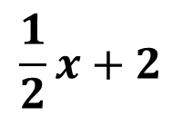
SIC_36
Quadthagoras!
The diagram shows a rectangle and one of its diagonals.
The dimensions given are in metres.
Find the value of $x$.
$$10$$
$$x$$
(not to scale)
$$\frac{1}{2}x+2$$

Slide 14

SIC_36
Quadthagoras!
The diagram shows a rectangle and one of its diagonals.
The dimensions given are in metres.
Find the value of $x$.
$$10$$
$$x$$
(not to scale)
$$2x−10$$

Slide 15

SIC_36
Quadthagoras!
The diagram shows a rectangle and one of its diagonals.
The dimensions given are in metres.
Find the value of $x$.
$$10$$
$$x$$
(not to scale)
$$3x−18$$

Slide 16
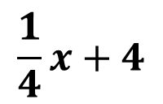
SIC_36
Quadthagoras!
The diagram shows a rectangle and one of its diagonals.
The dimensions given are in metres.
Find the value of $x$.
$$10$$
$$x$$
(not to scale)
$$\frac{1}{4}x+4$$

Slide 17



SIC_36
Quadthagoras!
The diagram shows a rectangle and one of its diagonals.
The dimensions given are in metres.
Find the value of $x$.
$$25$$
$$x−1$$
(not to scale)
$$3x$$

Slide 18

SIC_36
Quadthagoras!
The diagram shows a rectangle and one of its diagonals.
The dimensions given are in metres.
Find the value of $x$.
$$25$$
$$x−1$$
(not to scale)
$$2x+8$$

Slide 19
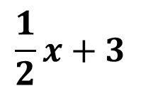

SIC_36
Quadthagoras!
The diagram shows a rectangle and one of its diagonals.
The dimensions given are in metres.
Find the value of $x$.
$$25$$
$$\frac{1}{2}x+3$$
(not to scale)
$$x+16$$

Slide 20
SIC_36
Quadthagoras!
The diagram shows a rectangle and one of its diagonals.
The dimensions given are in metres.
Find the value of $x$.
$$25$$
$$\frac{1}{2}x+3$$
(not to scale)
$$3x$$

Slide 21



SIC_36
Quadthagoras!
The diagram shows a rectangle and one of its diagonals.
The dimensions given are in metres.
Find the value of $x$.
$$3x+1$$
$$x−1$$
(not to scale)
$$24$$

Slide 22

SIC_36
Quadthagoras!
The diagram shows a rectangle and one of its diagonals.
The dimensions given are in metres.
Find the value of $x$.
$$4x−7$$
$$x−1$$
(not to scale)
$$2x+8$$

